Slide 1



ChemCorp Analysis
View in Power BI
Last data refresh:
5/28/2020 11:16:14 AM India Standard Time
Downloaded at:
5/28/2020 11:19:17 AM India Standard Time

Slide 2
Inspit of a impressive growth of 7% YoY, company is observing serious competition. A recent discussion with five long-term customers revealed that ChemCorp was no longer these firms’ preferred provider of chemicals. Company needs to lay down a short term approach to best address the loss of customers and protect the existing market share.
!
What products customers buy the most and the least.
Where most products are being bought.
How seasonality plays into the purchase of these products.
Problem 1
Understand Customer Strategy
!
Which industry provides the most revenue to ChemCorp at this point in time?
What industries have the highest profit margins and how is this reflected in the number of business customers per segment?
What products provide the highest profitability?
Problem 2
Market Opportunities
!
Which industries have the lowest overall profitability?
What products have the lowest profitability and number of business customers?
Problem 3
Product Divestment

Slide 3
Customer Strategy : Top and Bottom selling products and regions
Chemical D is top selling product and Chemical A is least selling product.
In terms of number of products sold, Middle Atlantic is the top region product and New England is least.

Slide 4
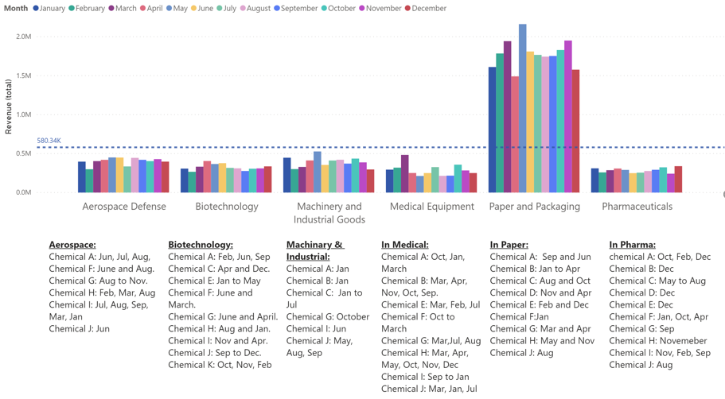
Customer Strategy: Seasonality Explained (By Industry and Chemicals) By Industry: Out of all months, May month contributed most in Revenue
May
May
May
March
April
December

Slide 5
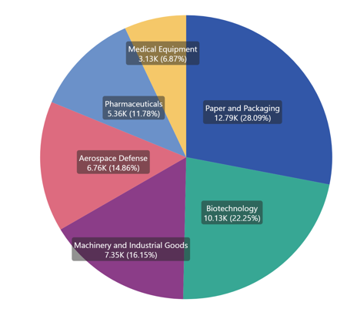
Market Opportunities: Paper and Packaging Industry is the top contributor with 28% of total revenue.

Slide 6
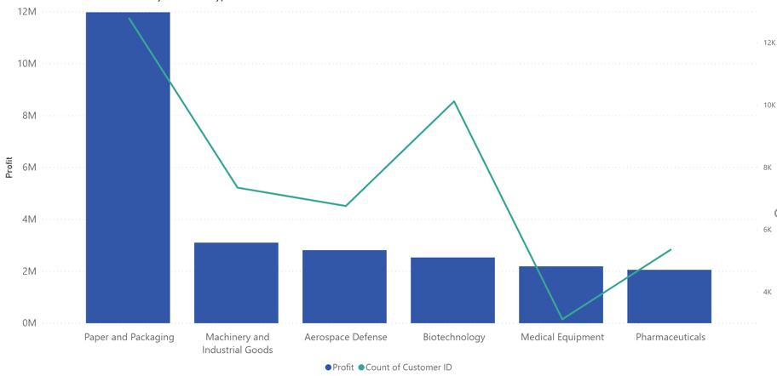
Market Opportunities: Paper and Packaging Industry is having most profit margin and customer base. In spite of having second position as customer base in Biotechnolgy, profits are low on 4th position. For medical equipment industry, low customer based but high margins.

Slide 7
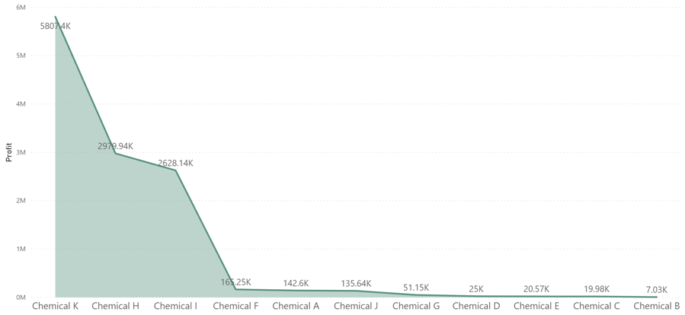
Market Opportunities: Chemical K is highest profit making product ($5.8 M) followed by Chemical H ($3 M) and Chemical I ($2.6 M)

Slide 8
Product Divestment: Pharmaceuticals Industry is having lowest profitability of $2 M.

Slide 9
Product Divestment: Chemical A has lowest Profitability ($0.27 B) and number of business customers (399) , followed by Chemical J with Profitability ($0.67 B) and number of business customers (707)

Slide 10
Summary
Customer Strategy:
Chemical D is top selling product and Chemical A is least selling product.
Middle Atlantic is the top region where most products are sold.
May seems to be most favorable season in terms of profitability
Market Opportunities:
Paper and Packaging Industry is the top contributor with 28% of total revenue.
Paper and Packaging Industry is having most profit margins and customer base.
Chemical K is highest profit making product ($5.8 M)
Product Divestment:
Pharmaceuticals Industry is having lowest profitability of $2 M.
Chemical A has lowest Profitability ($0.27 B) and number of business customers (399) so this product can be weed out from ChemCorp’s business.

